Slide 1

South African Soccer
Nomgqibelo Nkosi

Slide 2
Agenda
1.Dataset overview
2.League & Team summary
3.Player Performance Highlights
4.Financial Insights
5.Contract & Risk Analysis
6.Key Takeaways & Recommendations

Slide 3
Dataset Overview
1.300 players | 16 clubs | 34 columns
2.Key metrics tracked: Goals ,Assists , Salary ,Market Value ,Injury Status ,Contract end etc.
3.Insert small screenshot of the first few rows ( or just the column headers)

Slide 4
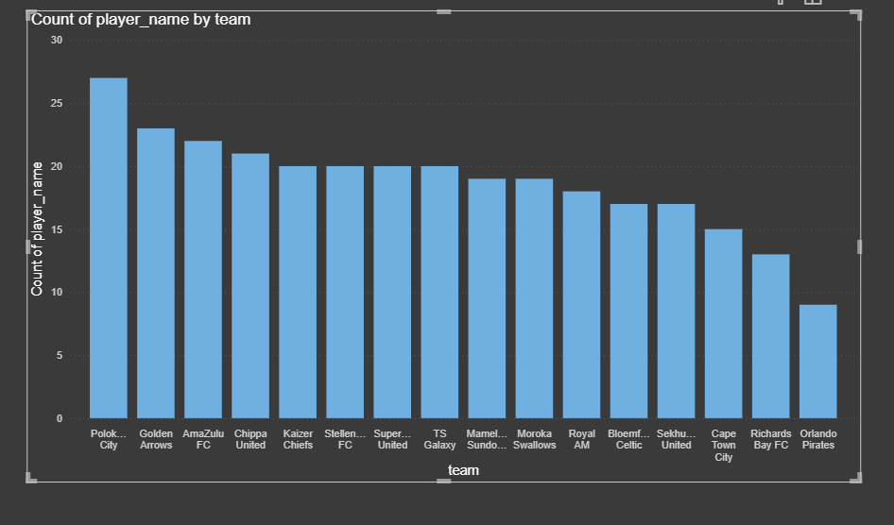
Total Players by Club (Clustered Bar Chart)

Slide 5
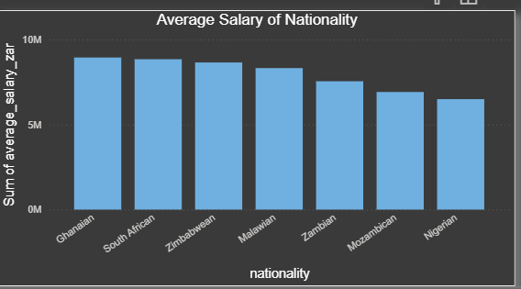
Nationality Mix (Bar Chart)

Slide 6
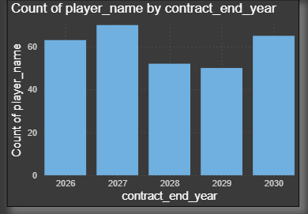
Contract & Risk Analysis
1.63 players out of contract in 2026 –massive transfer window
2.70 players out of contract in 2027
3.1.48 billion total market value risk.

Slide 7
Key Takeaway
Key Takeaway | Proof point | Icon
Polokwane City are the sleeping gaint | 1,300 goals (almost double 2nd place) | Trophy
Orlando Pirates & Cape Town are in crisis | Bottom 2 in goals despite big budgets | Warning
Shot accuracy does not equal goals | Correlation only 0.07 | Target
Royal AM the highest Salaries but are mid-table | Highest avg salary ,only 544 goals | Money
2026 will be the biggest free-agent window ever. | 63 players(21%) can leave for R0 | Calendar

